Slide 1
PIRS – Release Notes
Release 3.54

Slide 2
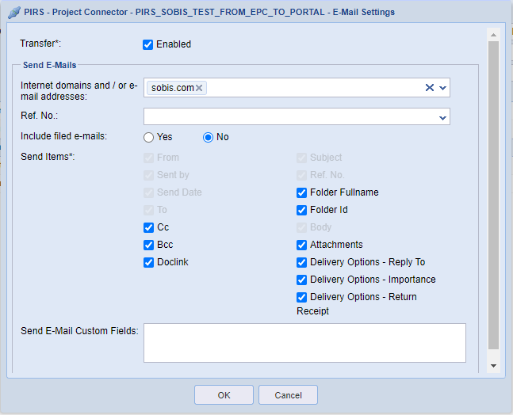
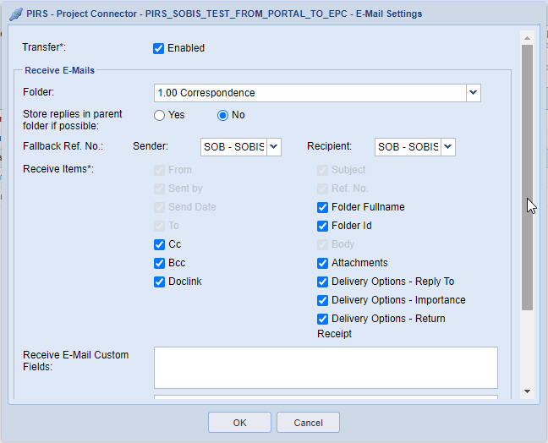
Send and Receive Custom Fields for Correspondence
Allows to transfer content from custom fields of correspondences to linked Portals / Smart Collaborations

Slide 3
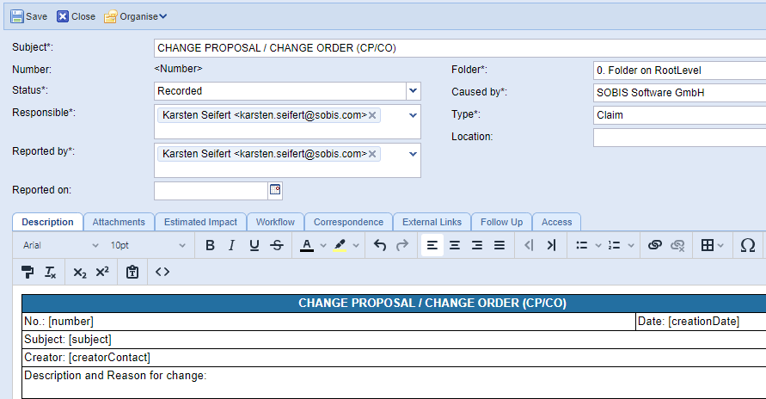
Use bookmarks in PIRS Text Templates
Define bookmarks in Text Templates so that the related information from PIRS will be extracted within PDFs or Create File from Templates

Slide 4
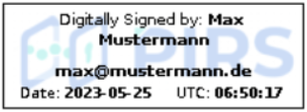
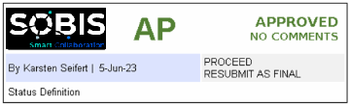
PIRS Digital Stamp / Custom Stamps
Provide option to integrate standard stamps / custom stamps into PIRS file viewer
SOBIS Examples below:

Slide 5
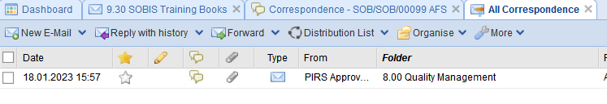
AFS – Allow to file mail in parent folder for Reply / Forward
In case of a Reply or Forward the mail is filed in the same folder like the parent mail.
Optional feature that must be defined as parameter for the Auto Filing rules:
{
matchSenders: [".*"],
matchTo: [".*"],
fileInFolder: "9.30 SOBIS Training Books",
useParentFolder:true
}

Slide 6
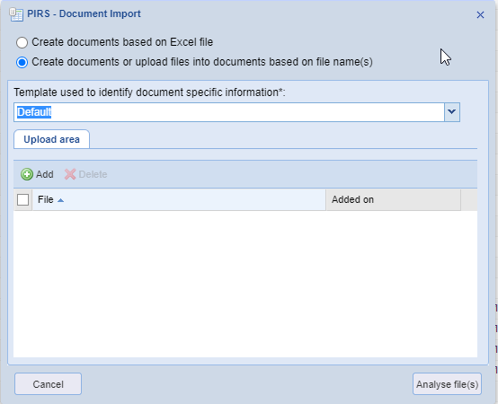
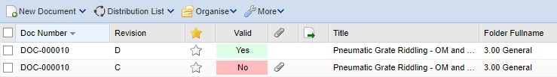
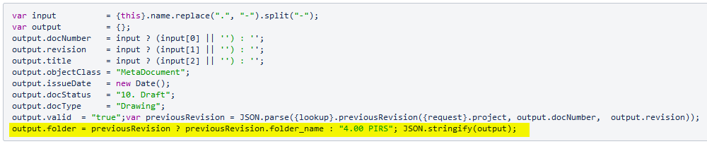
Create document based on file name – Use folder from previous revision
Further improvements for „Create documents or upload files into documents based on file name(s)“
It is possible to save Revision to the same folder like the previous Rev!
Requires appropriate configuration:

Slide 7
Map users to contacts via SyncContacts job
Automatism to map created contacts to PIRS users
No manual User – Project – Contact – Mapping needed
Only possible if contact synchronisation has been configured
Please talk to SOBIS to enable this feature in your projects.

Slide 8
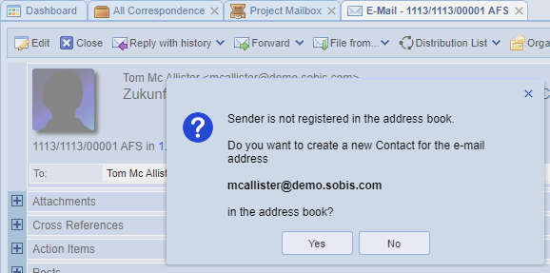
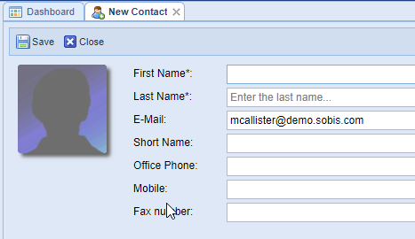
Add sender to address book from correspondence read mode
Allows to add senders directly to the PIRS address book in read mode of a correspondence

